Slide 1
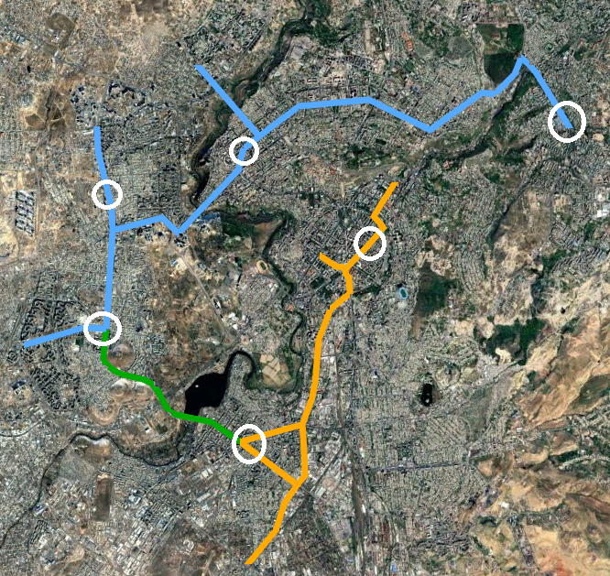
Parking Assessment
Parking Assessment
Our goal
• Analyse the existing parking system context along the priority corridors and in Yerevan as a whole.
• Assess the impacts of the conceptual corridor designs on parking supply.
• Evaluate the potential for parking displacement within the defined influence area.
• Identify mitigation options and parking management measures that support corridor implementation.
What we did
• Parking Supply Survey — desk inventory from 360° video, satellite and Yandex imagery, with ~15% cross-checked physically in the field.
• Parking Occupancy Survey — six representative areas, hourly license-plate sweeps, 07:00–24:00.
• Off-street context — major facilities on the corridors catalogued to test their potential to absorb displaced demand.
• All survey data published and explorable at http://yerevan-parking.vercel.app
Field occupancy survey areas
1

Slide 2
Parking Assessment
Parking Supply Survey
Across Corridors 1 and 2 and 100 m buffer
14,557
7,825
6,095
6,732
Total spaces inventoried
On-street, across 606 segments
On the corridors themselves
Off-street, across 239 facilities
On-corridor on-street supply by regulatory zone (6,095 spaces)
Free / unregulated 5,248 (86.1%)
Zone B (blue) – paid 534 (8.8%)
Zone A (red) – paid 246 (4.0%)
Taxi 67 (1.1%)
86% of corridor parking is free of charge — and barely organized
• Only 20% has signage and 14% has markings. Zone A is concentrated in Kentron (Nalbandyan 69, Abovyan 46, Amiryan 43); Zone B is almost entirely Komitas Avenue (522 of 534).
2

Slide 3
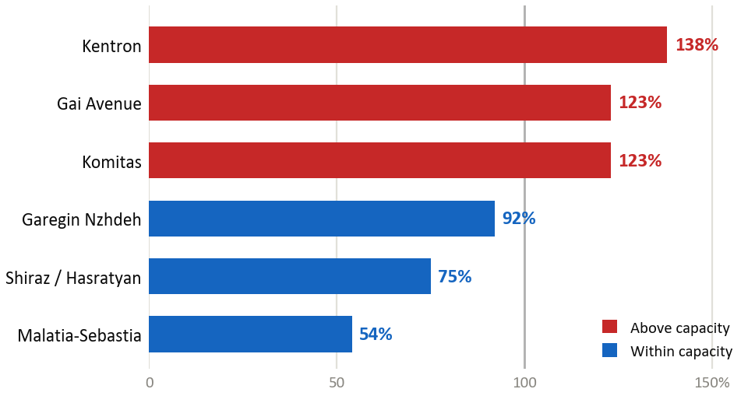
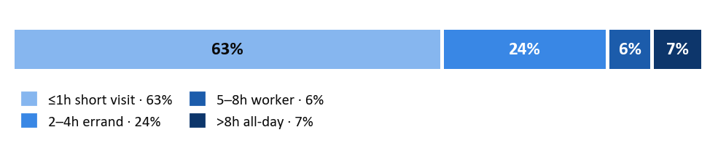
Parking Assessment
Parking Occupancy Survey
6 areas | hourly license-plate sweeps | 29 May - 3 June 2026 | 07:00–24:00
Peak occupancy by surveyed area
93%
1.8h
Peak occupancy, capacity-weighted
Average length of stay
5–11
63%
Vehicles per space per day
Of stays are one hour or less
How long vehicles stay
Peak occupancy = the total number of distinct vehicles recorded over the busiest hour ÷ the number of spaces (capacity-weighted). It is an hour-long count rather than a single snapshot, so a reading above 100% means more distinct vehicles than spaces used the kerb within that hour — the spaces turned over.
3

Slide 4
Parking Assessment
Occupancy survey results by area
The corridor average hides the spread — and the areas under the most pressure are the ones with the least room next door
Surveyed area
Peak occupancy
Zones over
85% at peak
Spaces
removed
Displaced
(% of spaces removed)
Re-absorbed
(% of displaced)
Avg. stay
Kentron (Corridor 1 core)
138%
89%
408
81%
10%
2.2 h
Gai Avenue (Mega Mall)
123%
90%
132
99%
68%
2.0 h
Komitas Avenue
123%
81%
253
89%
0%
1.8 h
Garegin Nzhdeh
92%
61%
286
52%
30%
1.7 h
Shiraz / Hasratyan
75%
47%
439
42%
69%
1.6 h
Malatia-Sebastia
54%
27%
368
27%
97%
1.6 h
Pressure and absorptive capacity run in opposite directions
• Kentron and Komitas peak over capacity yet re-absorb only 10% and 0% nearby; Malatia-Sebastia peaks at 54% and re-absorbs 97% — so the package is applied by zone, not uniformly.
Peak occupancy = distinct vehicles over the busiest hour ÷ spaces; above 100% means more distinct vehicles than spaces used the kerb in that hour. It sums each zone's own peak hour, so zones busiest at different times are added together. Displaced (% of spaces removed) instead counts one shared clock hour — a stricter basis, so the two columns are not directly comparable; on the single-hour basis Kentron reads 89% and Komitas 83%. Surveyed areas only, not corridor-wide. Source: field occupancy survey, 29 May – 3 June 2026.
4

Slide 5
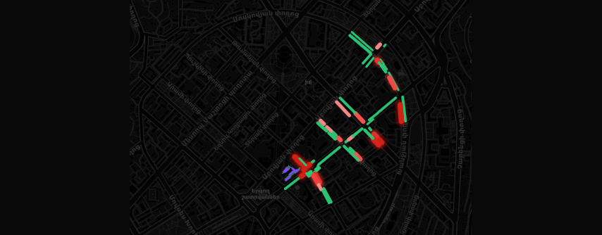

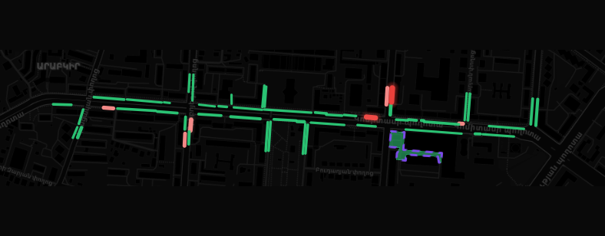
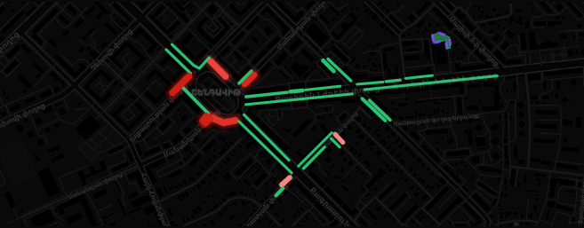
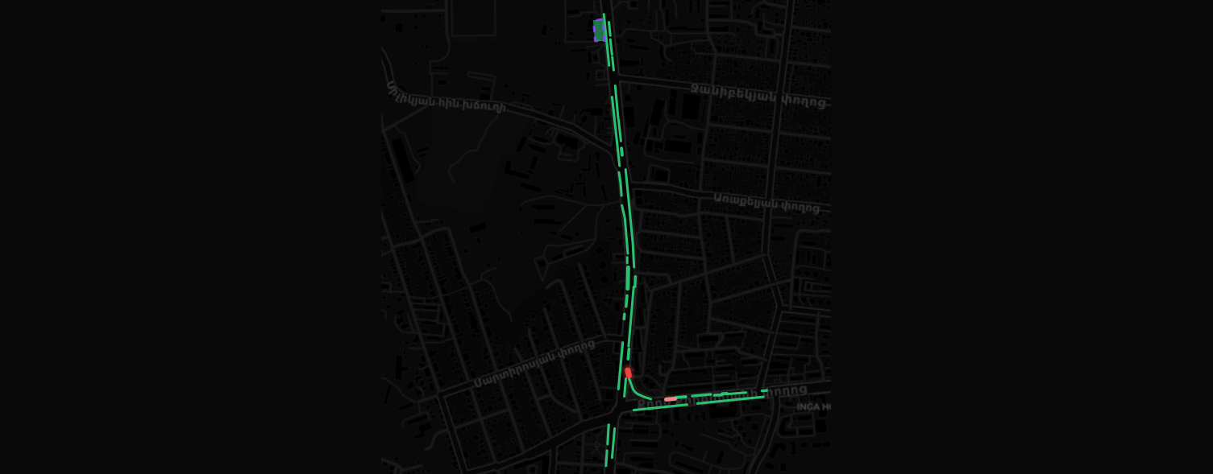
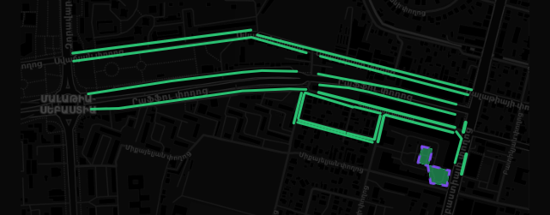
Parking Assessment
Occupancy Survey Locations
Kentron (Corridor 1 core)
138% peak
Gai Avenue (Mega Mall)
123% peak
Komitas Avenue
123% peak
Garegin Nzhdeh
92% peak
Shiraz / Hasratyan
75% peak
Malatia-Sebastia
54% peak
Measured occupancy
≤85% — within capacity
86–100% — at capacity
>100% — over capacity
Off-street yard (dashed)
5

Slide 6
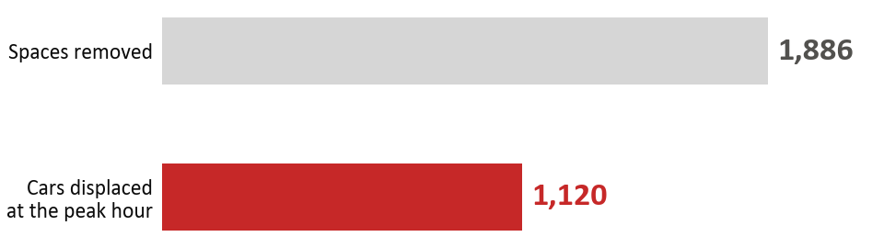
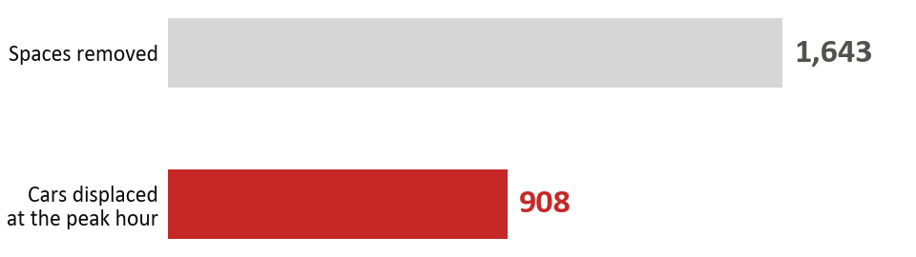
Parking Assessment
Design Impact & Displacement Assessment
The conceptual cross-section removes 80% of on-corridor parking
CORRIDORS 1 & 2 · impact of the conceptual design
Corridor 1: 1,480 · Corridor 2: 3,395
6,095
4,875
80%
1,220
On-street, on the corridors
On-street spaces removed
Of on-corridor parking
Retained or re-established
SIX SURVEYED AREAS ONLY · measured displacement
A demand overlay — not a re-survey of the full corridor
59%
35%
92%
Displaced vs. removed
Absorbed on-street
Capacity behind gates
Displaced demand = distinct vehicles in the removed zones at each area's single busiest hour, summed across the six areas.
Open and manage the yards BEFORE removing kerb: nearby streets absorb only 35% (10% in Kentron, 0% in Komitas). Re-absorption reaches ~100% only via off-street, and 92% of that is gated residential yards.
The 59% is the displaced demand set against the spaces removed in the same six areas (1,120 vehicles ÷ 1,886 spaces): the kerb is not full at the moment, so fewer vehicles need re-homing than spaces are lost. Corridor-wide figures cover Corridors 1 and 2 only — Corridor 3 is excluded pending its conceptual design — and will be updated once that design is finalized.
6

Slide 7
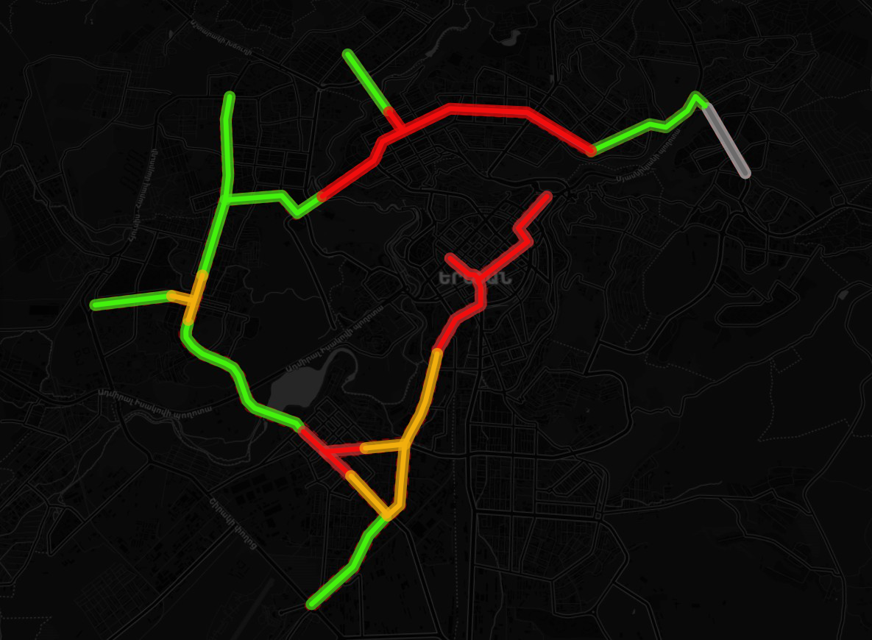









Parking Assessment
Mitigation Measures by Sensitivity Zones
No single measure resolves displacement - the package is applied selectively, by measured zone sensitivity
HIGH SENSITIVITY
Extend paid zones LEAD
Resident permits
Open residential yards
Visitor caps
Delivery bays
MEDIUM SENSITIVITY
Extend paid zones
Delivery bays
High
Medium
Lower
LOWER SENSITIVITY
Organise free parking
Open residential yards
Exception — Gai Avenue (Mega Mall)
• Kerb parking stays for now; revisit as the area changes - mall parking or the planned BRT.
7

Slide 8
Parking Assessment
Further studies and considerations
Parking is a citywide system and cannot be sustainably managed at corridor level alone
This component is scoped to the BRT corridors and their immediate influence area. The measures proposed here should therefore be understood as the first stage of a broader, citywide reform.
Extend the approach citywide
Supporting studies
• Extend the parking study beyond the corridor buffer to a citywide scale.
• Apply focused demand assessments at selected high-pressure locations, rather than corridor-wide observational surveys.
• Progressively expand the red-line zonal system into neighbourhoods currently outside it.
• Residential yard opening.
• Legal basis of the resident permit scheme.
Priority: who administers residential-yard opening
• The yards carry ~92% of the absorptive capacity that makes re-absorption work, yet no body currently owns the task. Who should lead it, and under what organisational and legal arrangement, warrants a dedicated study before any roll-out.
8

